Slide 1


We can read sight words.

Slide 2

he

Slide 3

was

Slide 4

for

Slide 5
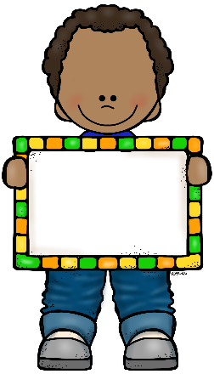
on

Slide 6

are

Slide 7

as

Slide 8
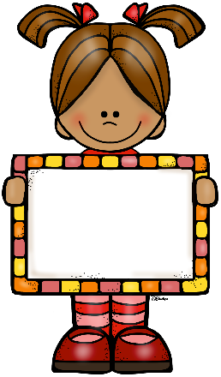
with

Slide 9

his

Slide 10
they

Slide 11
I

Slide 12

at

Slide 13

be

Slide 14
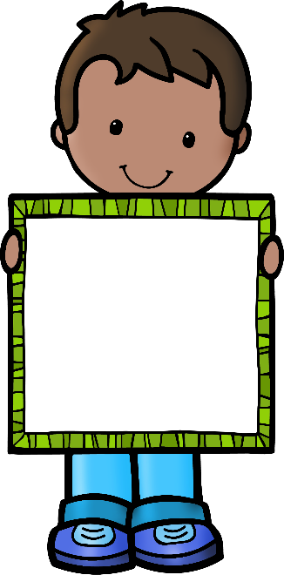
this

Slide 15

have

Slide 16
from

